Slide 1
A Project on
Store Management System
Presentation

Slide 2

Project Title : Stores Management System
DEPARTMENT OF COMPUTER SCIENCE AND
ENGINEERING
BANGLADESH UNIVERSITY OF BUSINESS AND TECHNOLOGY
SUMMER 2020

Slide 3
Project Title : Stores Management System
BANGLADESH UNIVERSITY OF BUSINESS AND TECHNOLOGY
SUMMER 2020
Supervised by:
Nahid Anwar
Assistant Professor
Bangladesh University of Business And Technology
Dhaka Submitted by:
Bangladesh Rakibul Ahasan || 17183103022
Sk.Abu Hanif || 17183103043
Abul Foyez || 16172103241
Dept of CSE || Intake : 39 || Section : 01

Slide 4
DECLARATION
Project Title : Stores Management System
I do hereby declare that, this project is an original work and was done under the supervision of Nahid Anwar, Assistant Professor , Department of CSE, Bangladesh University of Business And Technology, Mirpur - 2, Dhaka.

Slide 5
Roadmap
INTRODUCTION
Interface Requirement
User Interfaces
Hardware Interfaces
Software Interfaces
Goal of our Project
Project objective
Why We Need DSM Software
System Design
Benefits of Using a DSM System
ERD (Entity Relationship Diagram)
DSM Features
Web page Design
Database Design
Functional Requirement
Conclusion And Future Works
Motivation

Slide 6
INTRODUCTION
DSMS stands for Departmental Store Management System. This is a system that is used throughout the restaurant and retail industry. This computerized system allows business owners to track sales, cash flow, food inventory and can help simplify your bookkeeping enormously.
A Departmental Store Management System (DSMS) is an application that executes a collection of protocols to coordinate the actions of multiple processes on a network, such that all components cooperate together to perform a single or small set of related tasks. This system is good when one has an established Shop and wants his/her stores to blinked.

Slide 7
Motivation
Departmental Store Management System (DSMS), commonly found in retail establishments and known as DSM, often feature a complex arrangement of hardware, software and network connections. DSM systems rely on predictable operation, and any number of problems can appear when hardware, software or users do not perform as expected. So this perspective things Motivates me to kind of software in real time business.

Slide 8
Why We Need DSM Software
In the retail business, a good Departmental Store Management System is one of your biggest assets. If it works as advertised, it’ll be a lot like having your own team of experts working behind the scenes, making sure everything’s moving along quickly and efficiently. To remain on top in today’s highly competitive retail landscape, you need a DSM system to help you run your business the right way here’s why.
Quick and Accurate Sales
Inventory Control
Know Your Customers
Save Time!

Slide 9
Why We Need DSM Software
Know Your Customers : Sales and inventory might be one and two, but everyone knows the customer is always right. Without real people coming in you won’t have sales and there will be no need to stock any inventory. A Departmental store management system should give you the ability to track all of your customers so you can see which customers are big spenders, who is waiting for a special order, and who has a layaway on that product tucked away in the back room.
Save Time!
There’s one thing that we could all use a little more of: Time!There’s one thing that we could all use a little more of: Time! Possibly the thing you’ll love the most about a Departmental store management system is the time it will save you.

Slide 10
Why We Need DSM Software
Quick and Accurate Sales : It all comes down to sales. If you aren’t making sales you aren’t going to stay in business. Sales are the core of your business and how you handle this process is essential to your success. A DSM system makes sure that everything runs smoothly on every transaction.
Inventory Control : If sales are number one, good inventory control is a close second. Without good inventory control you miss out on sales, overstock unwanted products, and lose out on high profit margins. A DSM system will keep an accurate count of every product in your store. It allows you to see what items are selling, what’s sitting on the shelf, and what you need to order.

Slide 11
Goal of our Project
01
Web Based or Mobile DSM: Our works on Mobile, Tab and PC system you can use one or more than one Platform. It works offline.
02
Mobile Friendly: You can operate and see details of the shop on your mobile phone.
03
Customer History: Keep all your customer information in one place. It keeps customer And purchase history.

Slide 12
Project objective
Departmental Store Management (DSM) system provides businesses with the ability to computerize, systematize and correlate retail information. Where cash registers, including complex register systems, have limited information collection capacity, DSM systems can gather, store and return detailed reports on inventory trends and customer information. Additionally, DSM systems more easily integrate with numerous sales and ordering systems.

Slide 13
Benefits of Using a DSM System
The right Departmental store management system will give you control over many different areas of your business operations increasing efficiency and profitability. A Departmental store management system will streamline business operations, including inventory and vendor management along with streamlining Departmental store management system processes. The following overview, categorized by area of operation, highlights some of the typical benefits of using a Departmental store management system.
Inventory : A Departmental store management system allows you to categorize your inventory by a number of fields for easy lookup and sorting of your merchandise.
Purchasing : A Departmental store management system will help you replenish items efficiently and negotiate lower vendor costs. You can quickly generate purchase orders and add items on the fly.

Slide 14
Functional Requirement
Functional requirements are-
Login
Simple one step login system
Admin Login
Administrator Dashboard
Admin can control whole system easily
Admin can add/delete sales person, Edit, update, delete, generate etc
Admin show payment option.
Purchases Role:
Bills
Payments
Vendors
Items Role
Add Items
Search Items
Show Items
Sales Role:
Invoices
Revenues
Customers

Slide 15
Interface Requirement
User Interfaces
Login Screen
Registration Screen
Profile Screen
Dashboard Screen
Items Screen
Sales Screen
Purchase Screen
Hardware Interfaces
Server Configuration: Minimum 4GB Hard Disk
P-III processor or equivalent
Ram 512 MB
Windows with Apache preloaded
Client Configuration
Software Interfaces
Operating system = windows 10
Language = C#
Database = MYSQL

Slide 16
Languages And Tools
01
C#.Net
Microsoft SQL Server 2014
02
03
Visual Studio 2019
MYSQL
04

Slide 17
DSM Features
Here Departmental store management system features are:
Log In Admin person
Add New Sales person
Delete sales person
Add New Items
Search Items
Update Items(Edit/Delete)
Add new Invoices
Search Invoices
Update Invoices(Edit/Delete)
Add new Revenues
Search Revenues
Update Revenues(Edit/Delete)
Add new Customers
Search Customers
Update Customers(Edit/Delete)
Add new Bill
Search Bill
Update Bill(Edit/Delete)
Add new Payments
Search Payments
Update Payments
Add new Vendors
Search Vendors
Update Vendors
Print Invoices
Print Bills

Slide 18
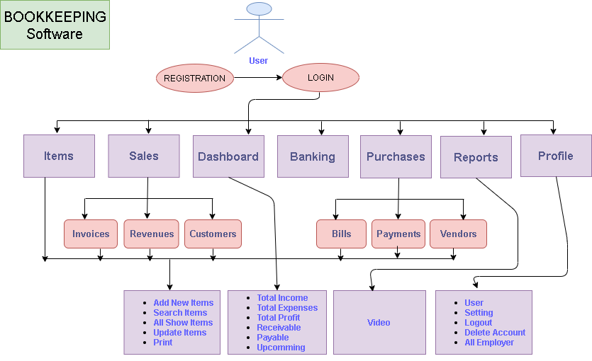
Use case diagram of DSM

Slide 19
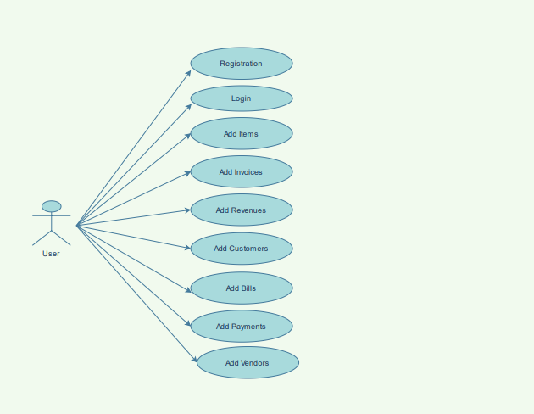
Use case diagram of DSM (User Part)

Slide 20
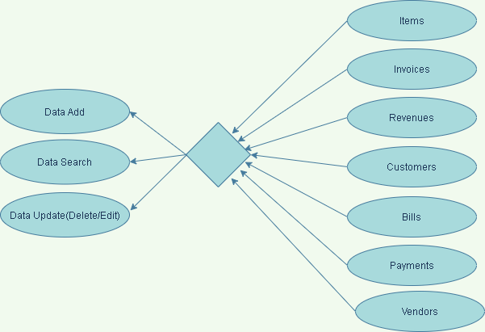
Use case diagram of DSM (Product Part)

Slide 21
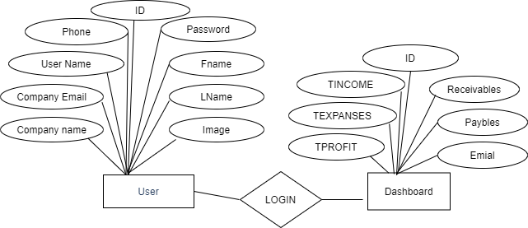
ERD (Entity Relationship Diagram)

Slide 22
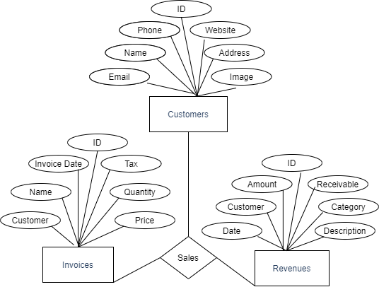
ERD (Entity Relationship Diagram)

Slide 23
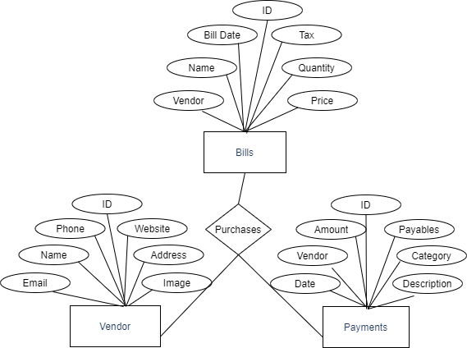
ERD (Entity Relationship Diagram)

Slide 24
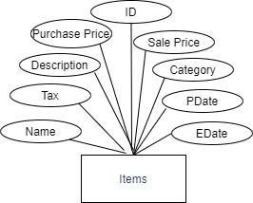
ERD (Entity Relationship Diagram)

Slide 25
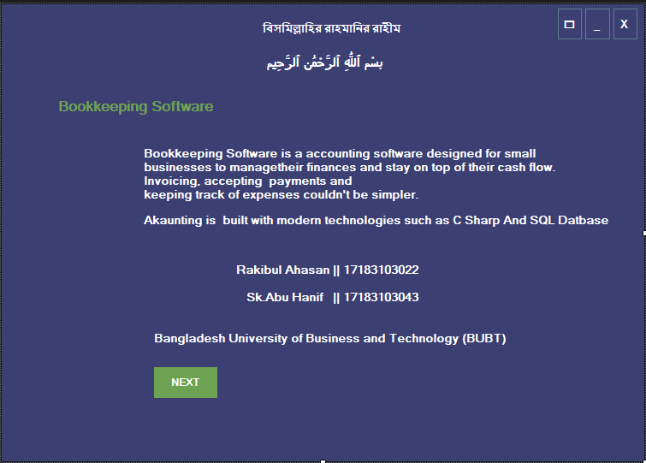
Web page Design

Slide 26
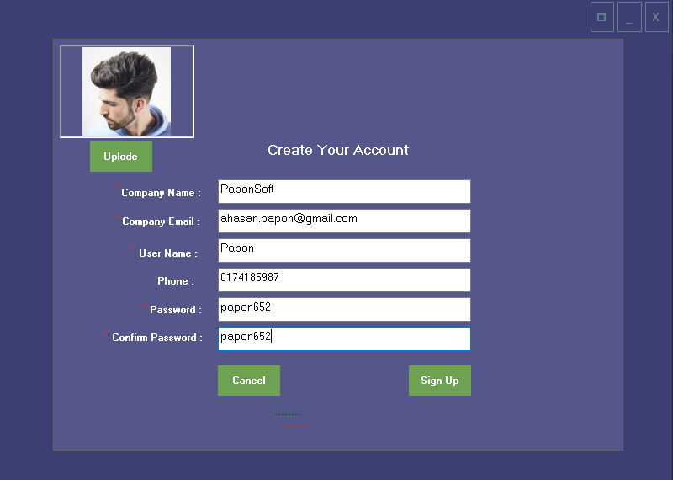
Web page Design

Slide 27
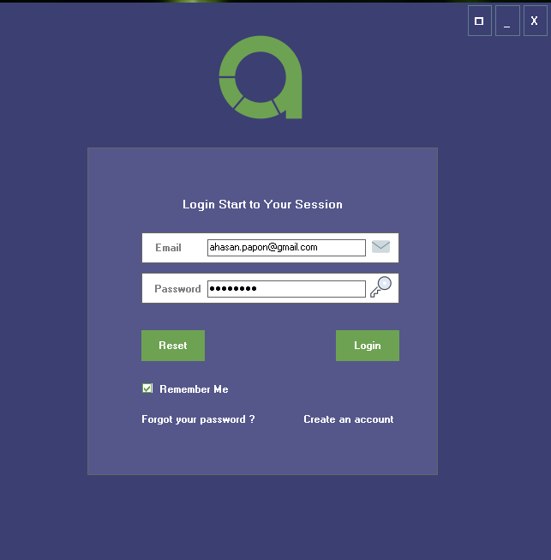
Web page Design

Slide 28
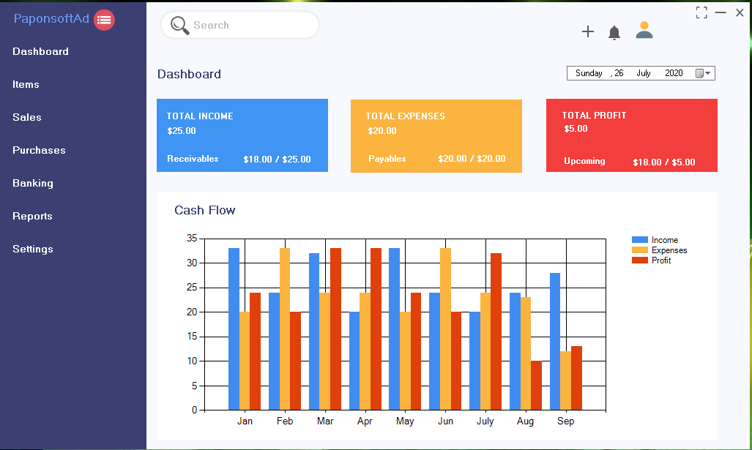
Web page Design

Slide 29
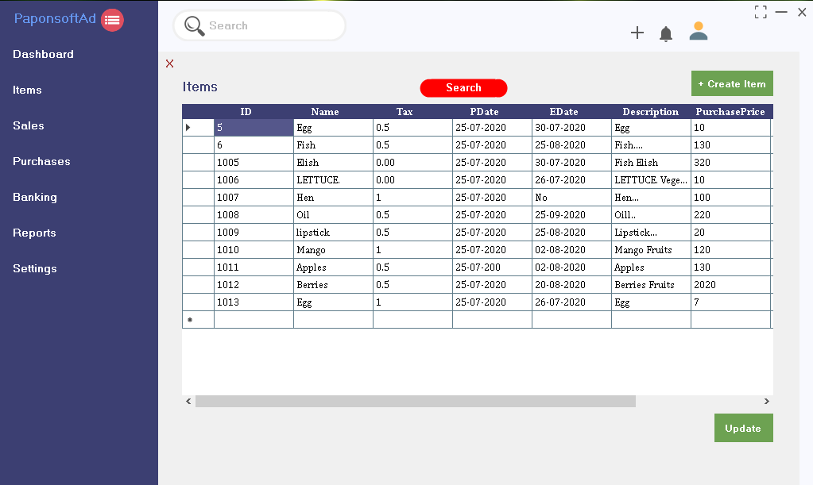
Web page Design

Slide 30
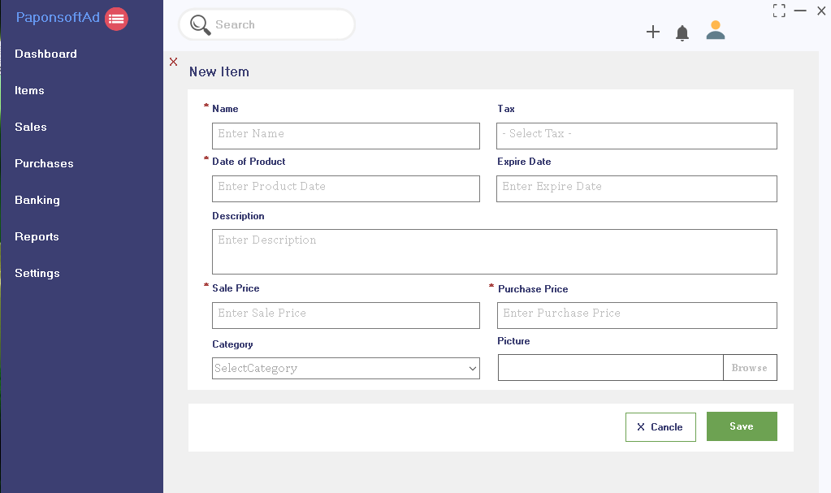
Web page Design

Slide 31
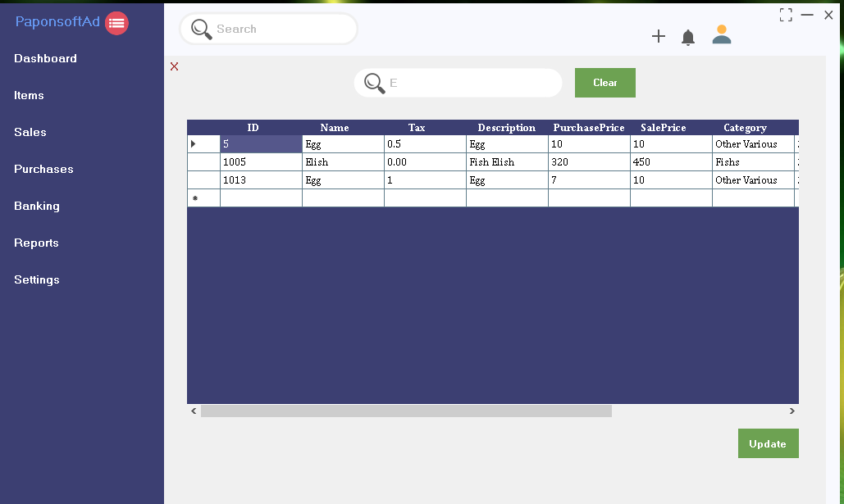
Web page Design

Slide 32
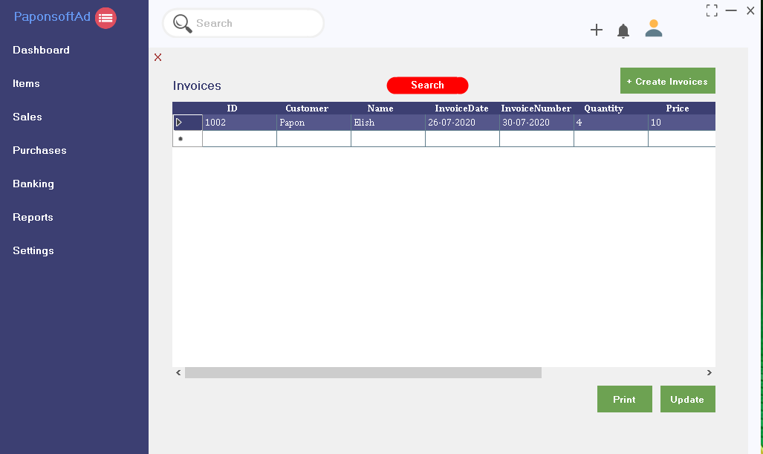
Web page Design

Slide 33
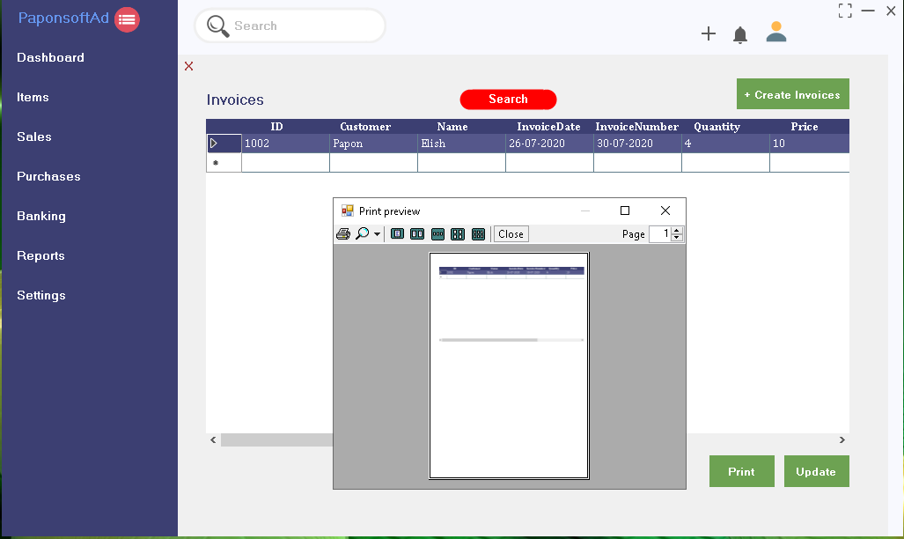
Web page Design

Slide 34
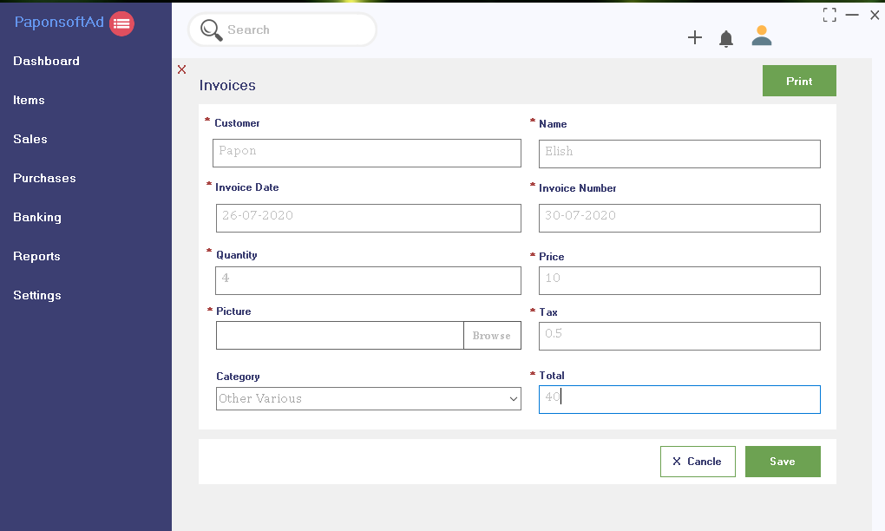
Web page Design

Slide 35
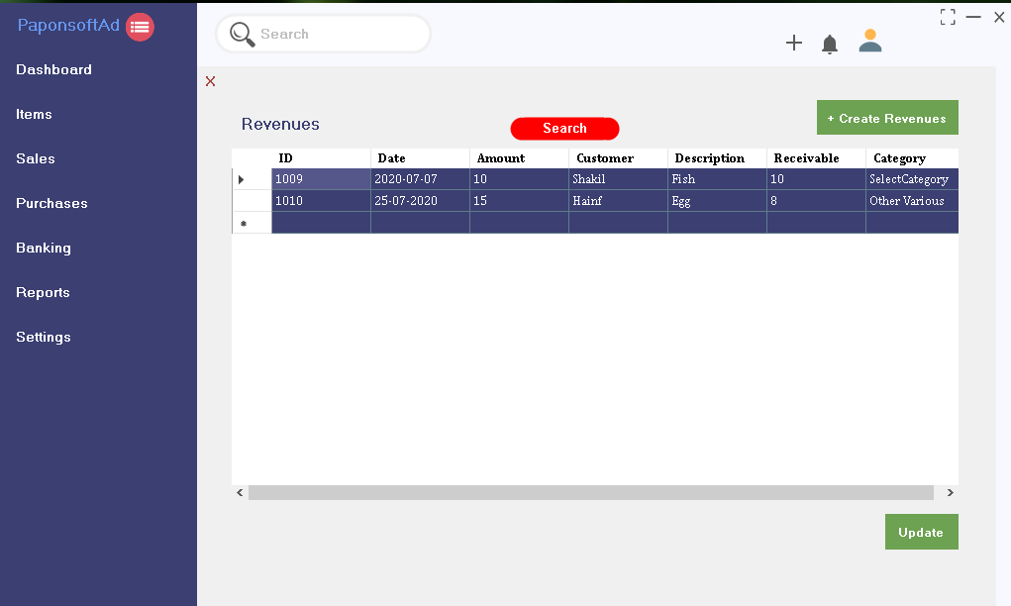
Web page Design

Slide 36
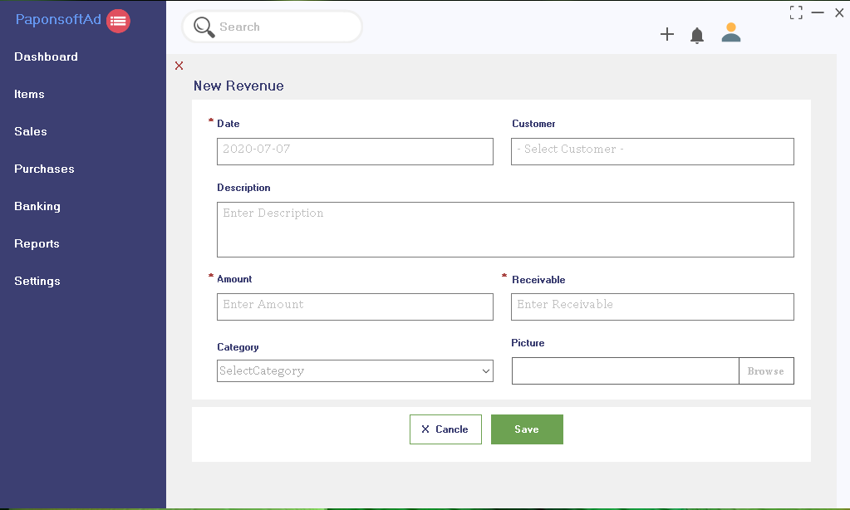
Web page Design

Slide 37
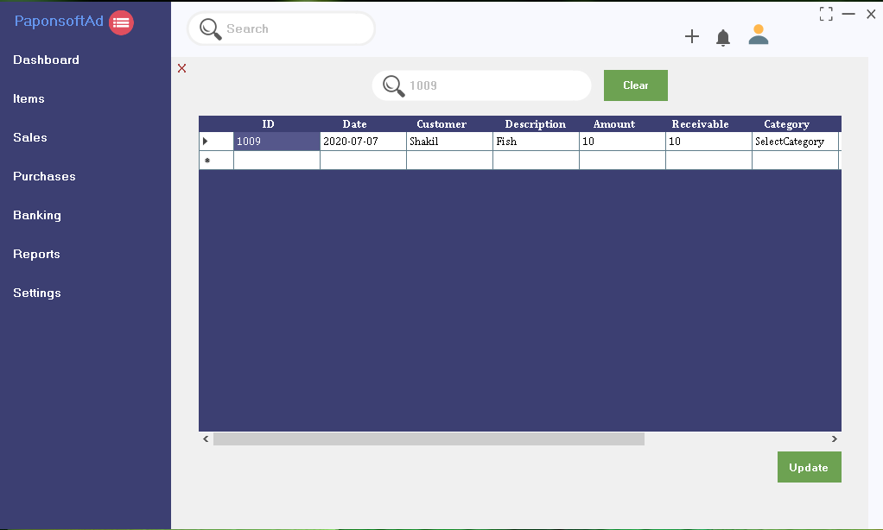
Web page Design

Slide 38
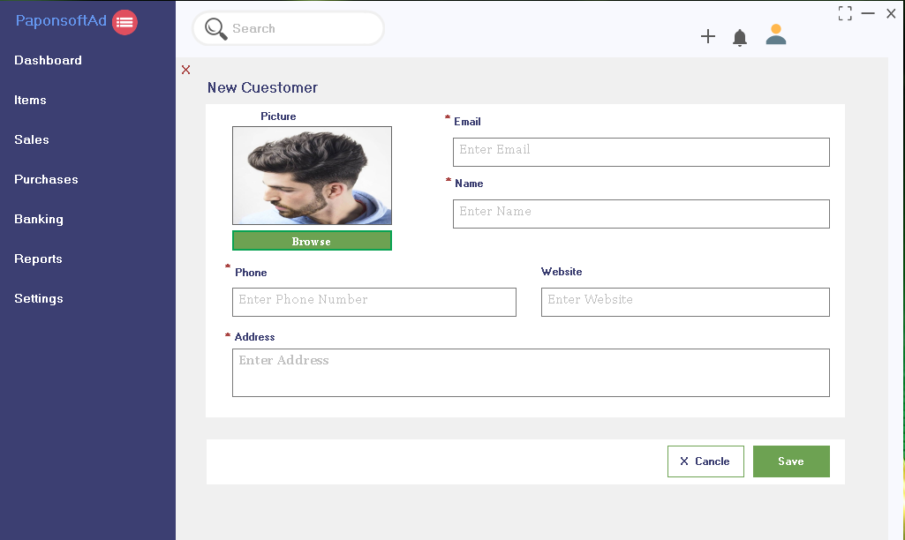
Web page Design

Slide 39
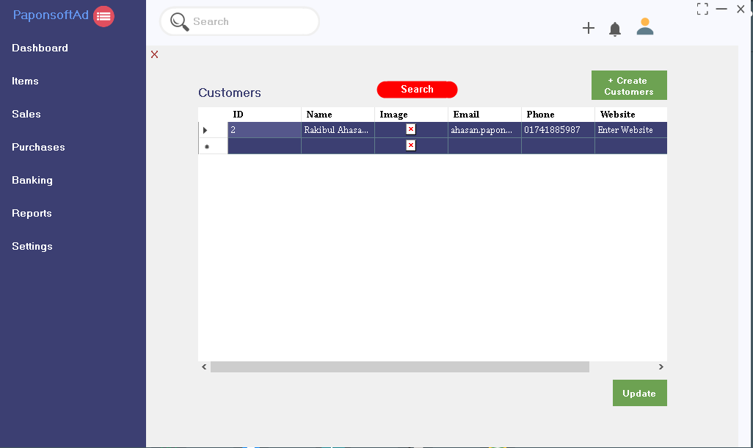
Web page Design

Slide 40
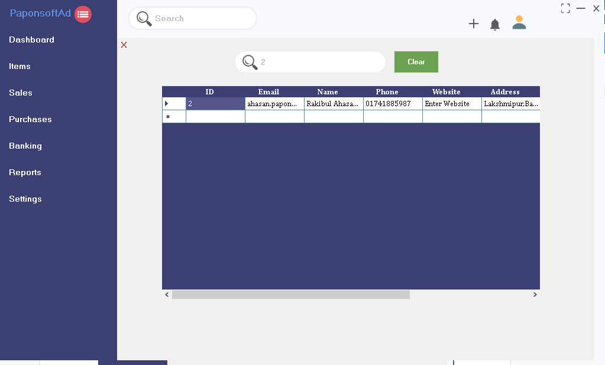
Web page Design

Slide 41
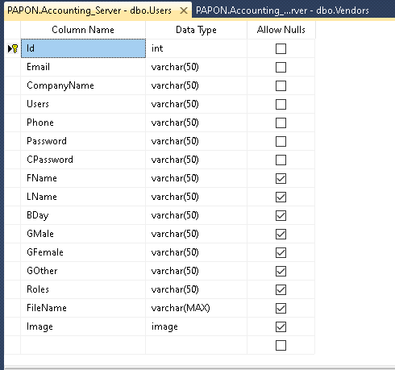
Database Design

Slide 42
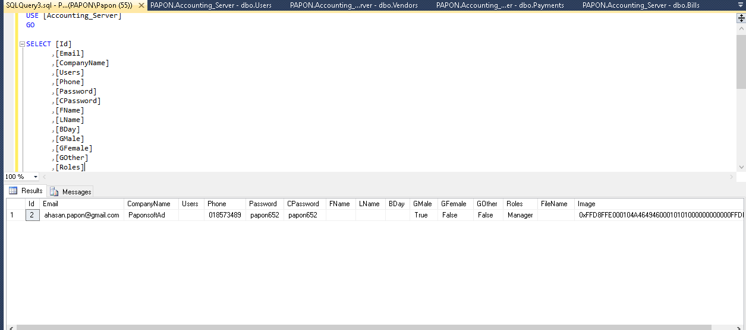
Database Design

Slide 43
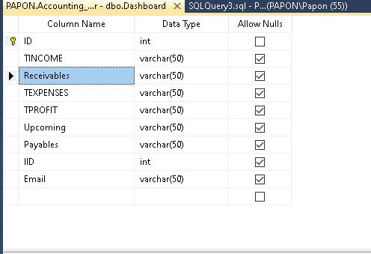
Database Design

Slide 44
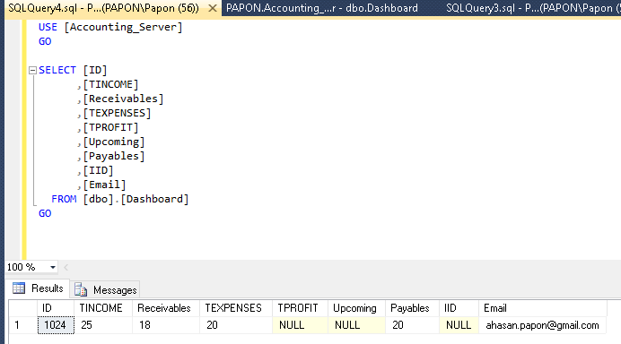
Database Design

Slide 45
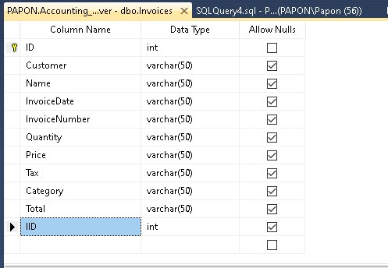
Database Design

Slide 46
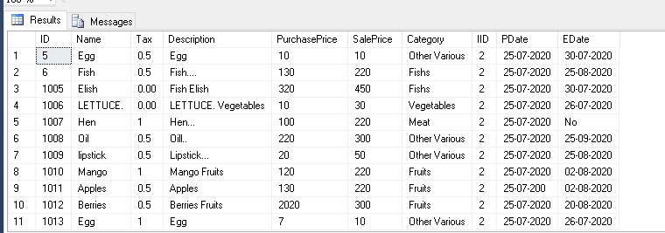
Database Design

Slide 47
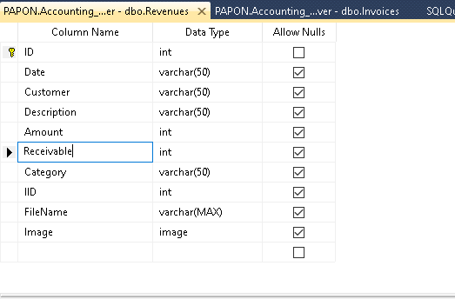
Database Design

Slide 48
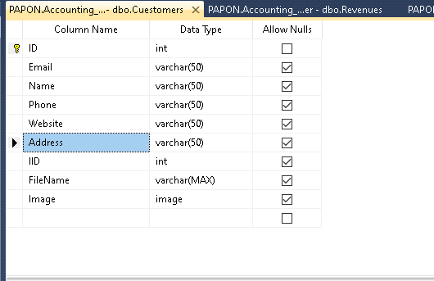
Database Design

Slide 49
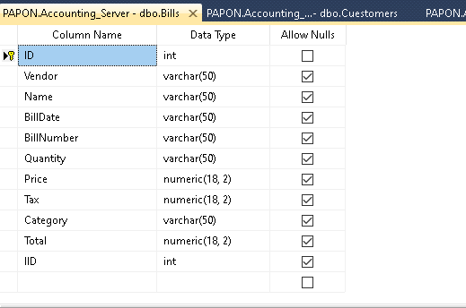
Database Design

Slide 50
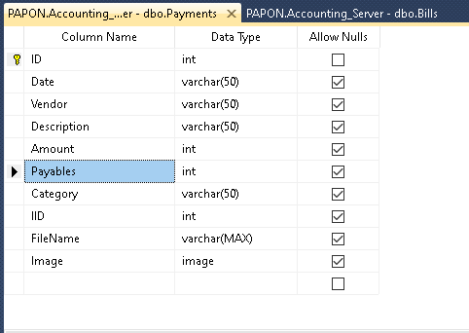
Database Design

Slide 51
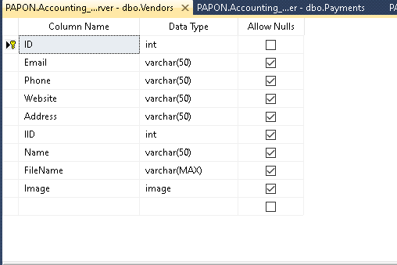
Database Design

Slide 52
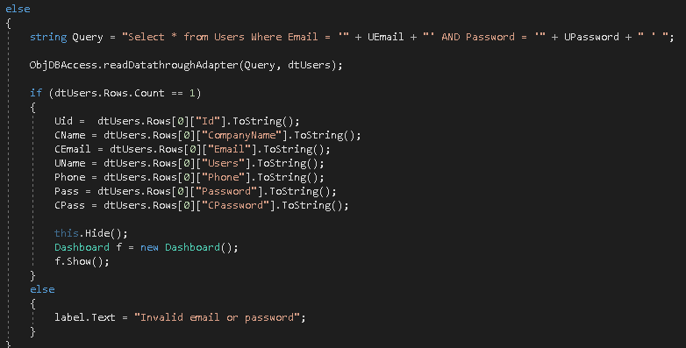
Database Design

Slide 53
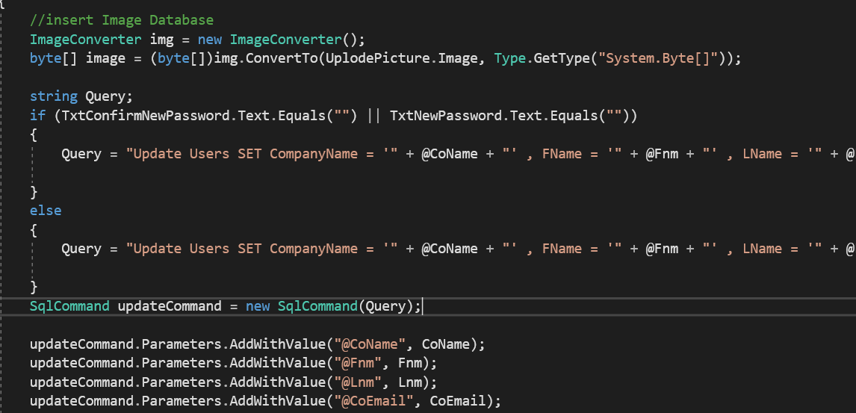
Database Design

Slide 54
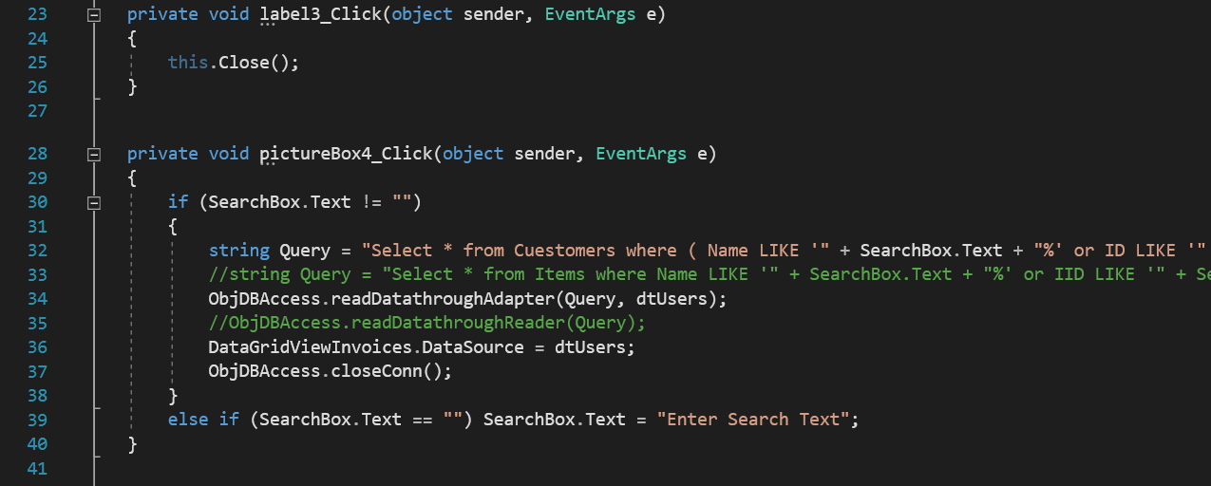
Database Design

Slide 55
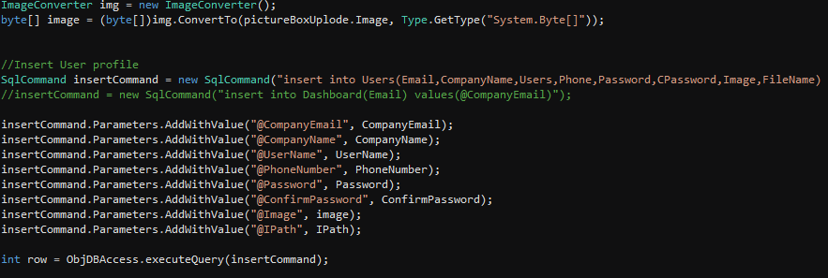
Database Design

Slide 56
REFERENCES
[1] Ian Somerville, “project planning”, Software Engineering Pearson Education, Update 8th Edition, 1989-1992.
[2] http://en.wikipedia.org/wiki/Point_of_sale
[3] https://www.geeksforgeeks.org/
[4] https://www.w3schools.com/
[5] https://stackoverflow.com/

Slide 57
Conclusion And Future Works
Now words any mini shopping mall don’t have an online DSM software. We have to work it to have online based DMS software for a Mini Shop. So that, their transaction process and payment report should be clear. In our country we find many shopping mall, they are used desktop base DSM software and fact many problems .So, we made an online base DSM system software to improve that system and also developed our country.
we has done proper in this project are compliantly logical business model and it's really sequential effective project.
DSM works offline So,we made an online base DSM system software.

Slide 58


Thank You!

